Slide 1

Herding Cats
Lessons in Sawdust
by
Gary Misan, and
Ken Godden

Slide 2
Today’s talk
aim of the Shed … (and of Men’s Sheds in general)
a brief history
where we are now
  grants & awards
  infrastructure
  products
  services
  community awareness
  member outcomes
where we want to be
lessons learned
challenges & solutions

Slide 3
Aim
To improve the social and emotional well being of Whyalla men of all ages and backgrounds –
  male friendly
    predominantly by men and for men
    welcoming, informal, non-secular, non-judgmental
  multi-function space
    spaces for social, trade and other activities
    a setting for informal teaching, learning and mentoring
    health promotion and health information

Slide 4
a brief history
When | What
Nov, 2012 | UniSA funding for Project officer
Nov – Dec, 2012 | public meetings
Jan, 2013 | working group established
Apr,2013 | incorporation
May, 2013 | regular meetings at knight st
May – Dec, 2013 | busy, busy in Gary’s shed
Jul, 2013 | charitable status, ABN, TFN
Nov, 2013 | lease signed for Holy Trinity Church
Jan, 2014 | work begins
Sep, 2014 | official opening
Oct, 2014 | first AGM
Nov , 2014 | SA Community Achievement Award
Jul, 2015 | work continues

Slide 5
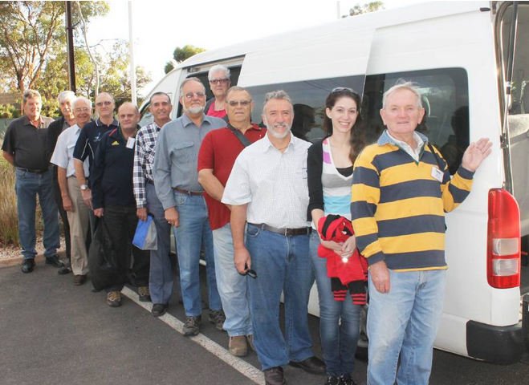
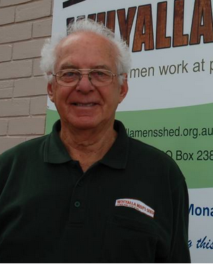
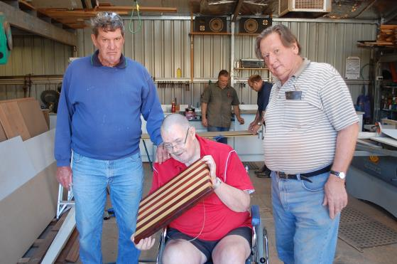
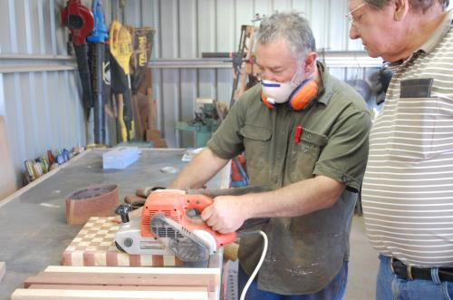
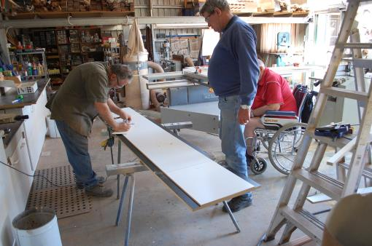
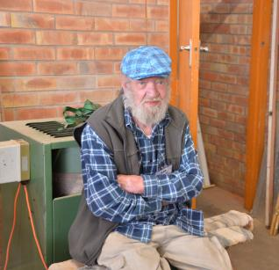
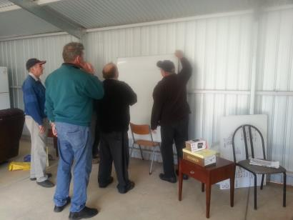
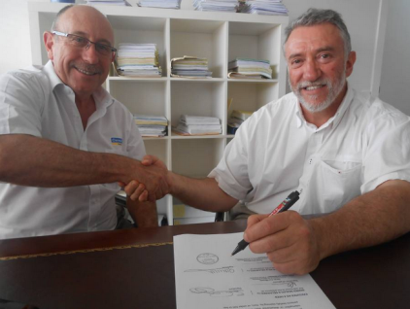
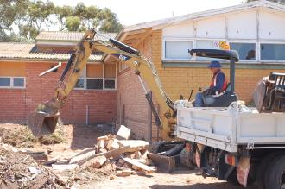

Slide 6
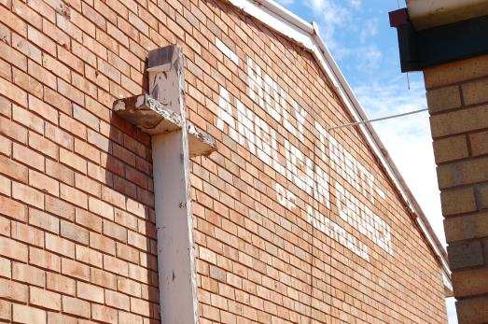
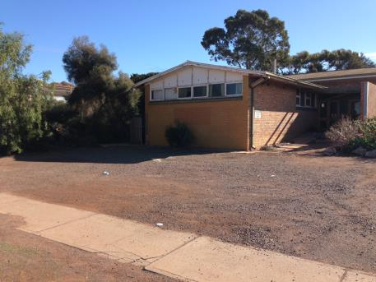
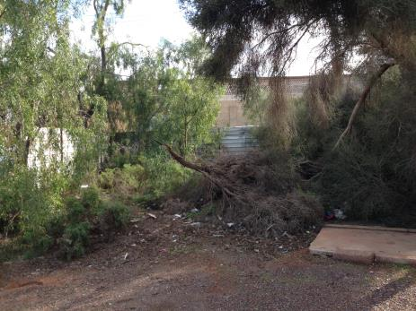
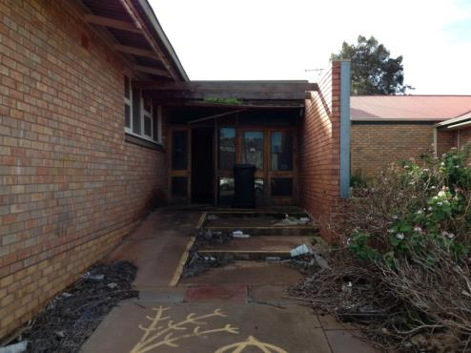
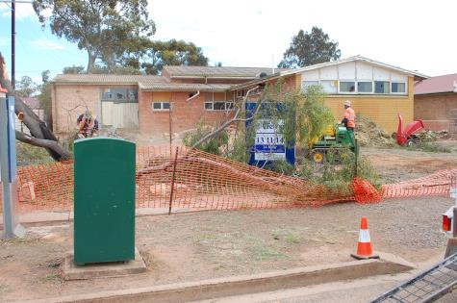
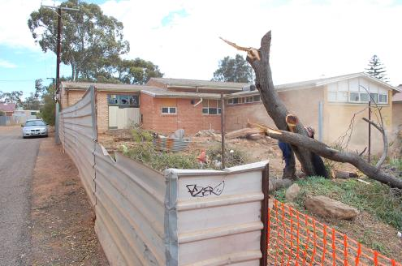
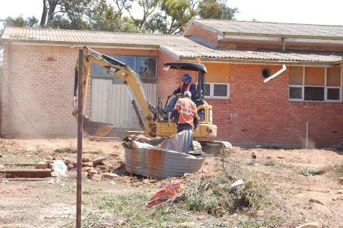
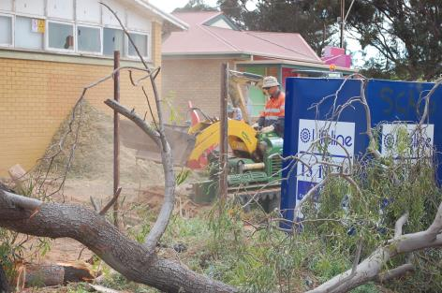
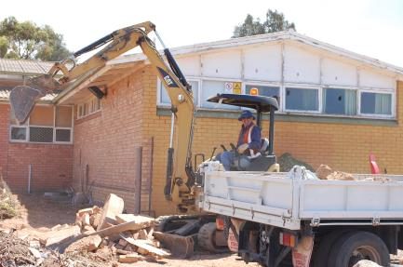

Slide 7
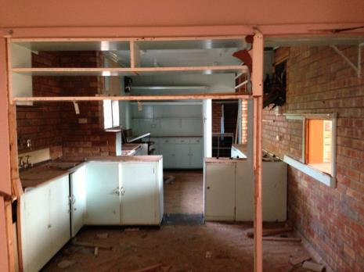
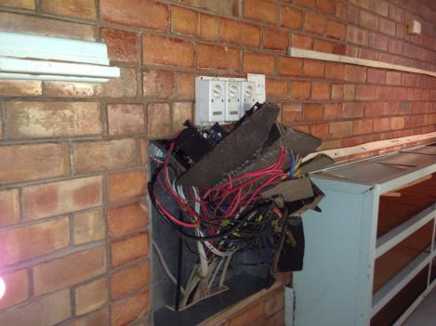
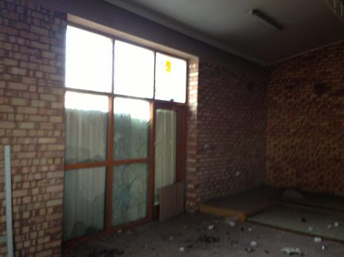
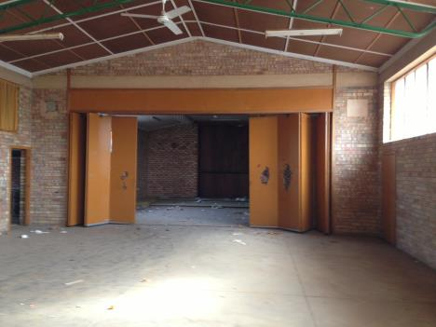
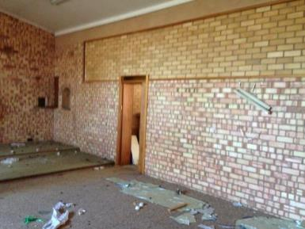
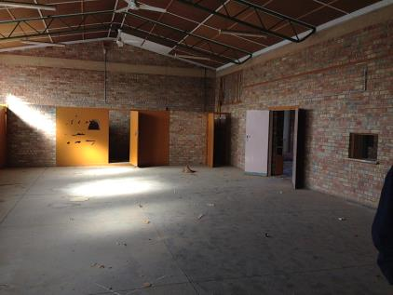
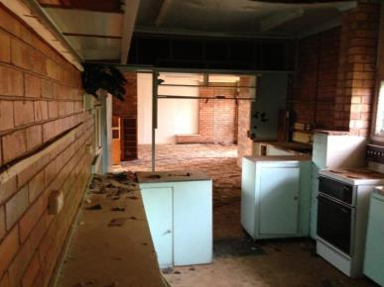
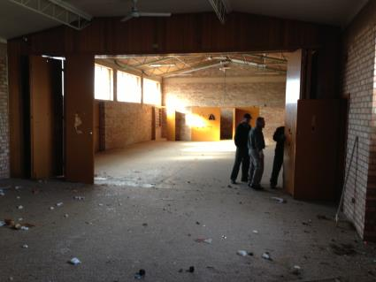
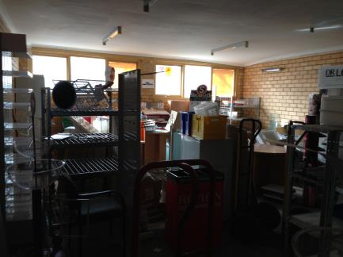

Slide 8
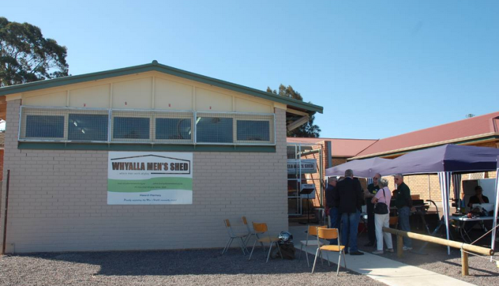
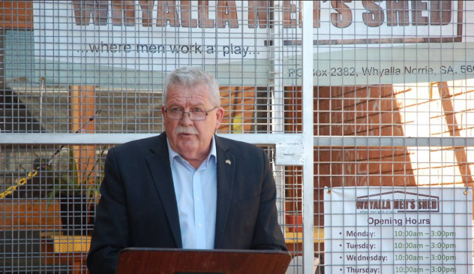
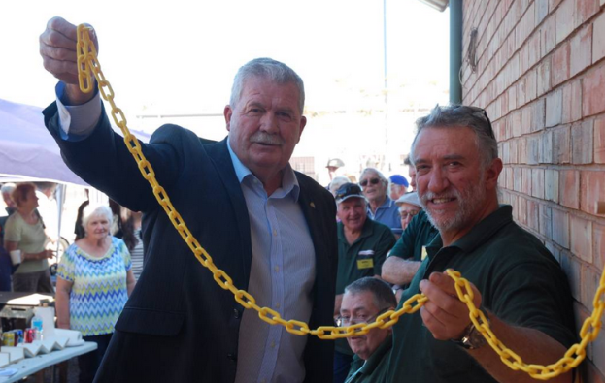

Slide 9
current status

Slide 10
grants
When | Who | Amount | Purpose
Mar, 2013 | AMSA | $2,800 | woodshop machines
Jul, 2013 | Council grant 1 | $500 | open day
Aug, 2013 | Council grant 2 | $2,500 | disabled toilet
Sep, 2013 | FACHSIA | $5,000 | non-fixed miscellaneous
Mar, 2014 | SA Govt, First Aid | $900 | first aid training
Jun, 2014 | Community Benefits SA | $5,000 | workshop tools / machines
Jun, 2014 | Medibank Private | $7,300 | outdoor recreation area
Oct, 2014 | YTAP | $8,300 | carpets, ceiling, internet
Sep, 2014 | EPCF | $1,000 | fire extinguishers
Dec, 2014 | SANTOS | $10,000 | metal shop equipment

Slide 11
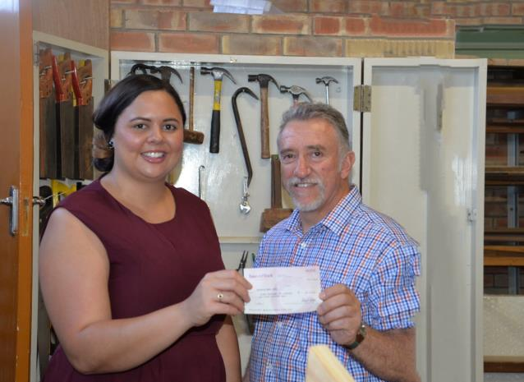
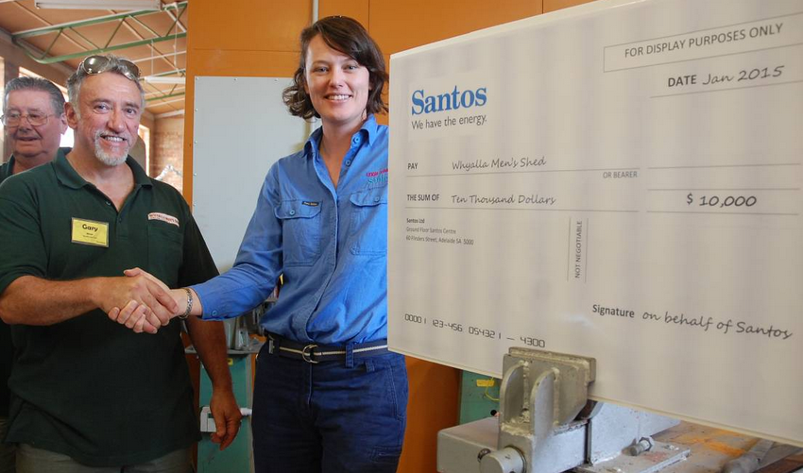
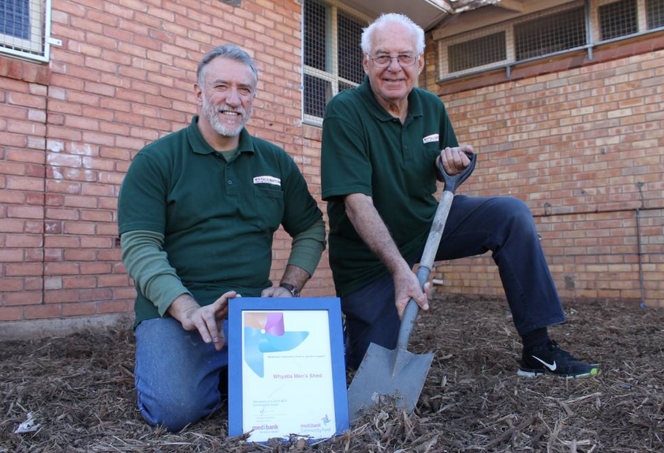

Slide 12
infrastructure
common room
games room
office area
kitchen
storeroom
wood and metal shop
storage racks, benches, shelving
outdoor area
disabled toilet
fences, security grills
new ceilings, carpets
plumbing, electrical (single / 3 phase), termite treatment

Slide 13
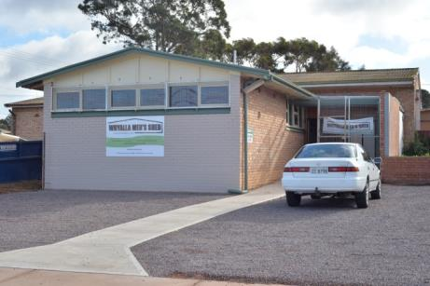
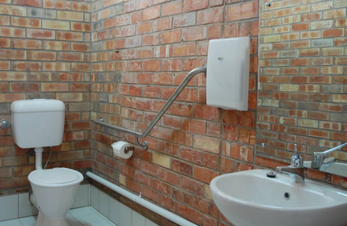
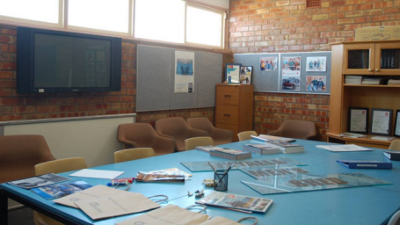
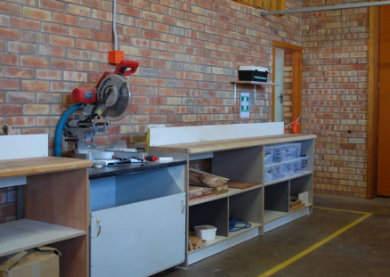
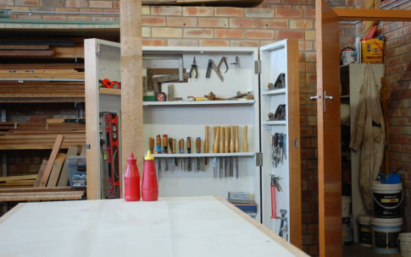
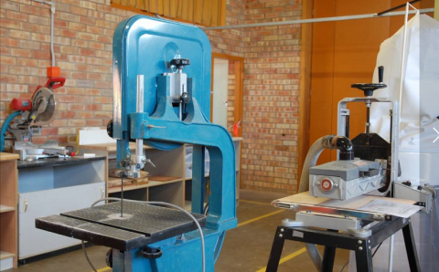
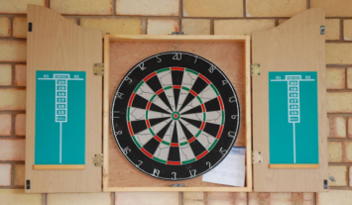
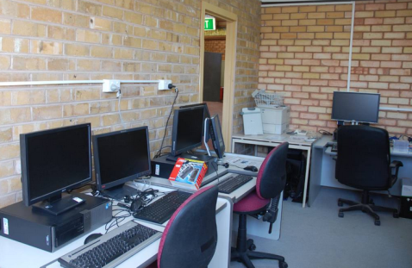
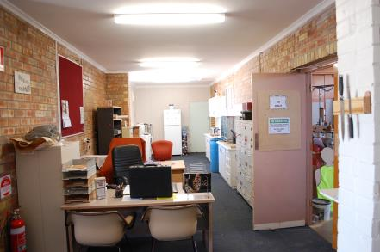
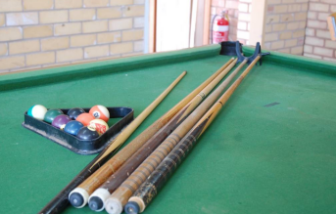


Slide 14
products
Mainly wood at present ..
  Trays
  Cutting boards
  Display racks
  Wooden toys
  BBQ racks
  Paper towel / toilet roll holders
  Utensil holders
  Shuffle boards
Etc

Slide 15
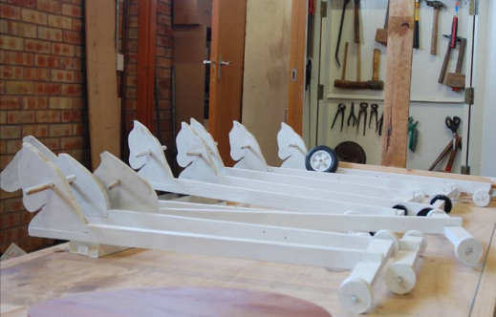
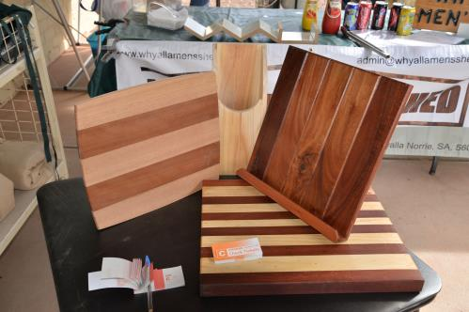
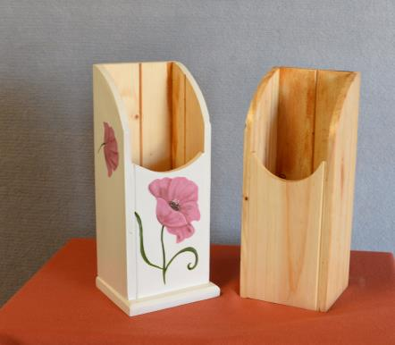
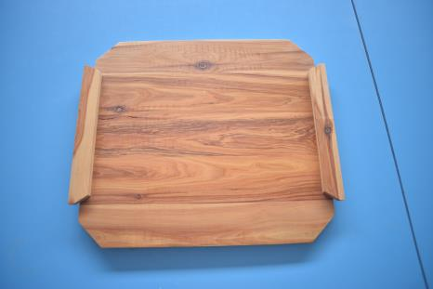
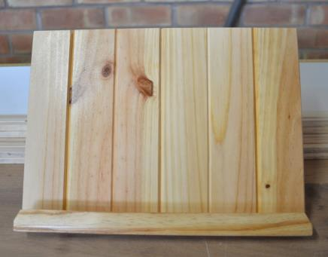
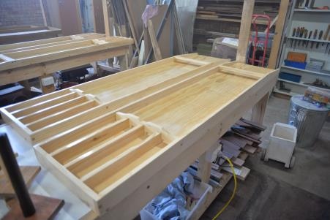
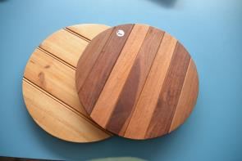





Slide 16
services
small construction jobs
furniture restoration & repairs
community projects

Slide 17








Slide 18
community awareness
Public meetings
Community notices – TV, Newspaper, radio
Web site / Facebook
Brochure
Whyalla News stories
Southern Cross TV
Display booths at -
  Male-Out
  Pride in the Park
  Fishy Fringe
  Whyalla Show
Fundraising BBQs

Slide 19





Slide 20
member benefits
new, male friendly environment offering range of interests
able to mix with men of diverse backgrounds & skills
improved social & emotional wellbeing
  reduced social isolation
  male bonding / camaraderie / fun
  people to talk with / share experiences / problems
  improved self esteem / sense of purpose
  renewed sense of identity / belonging
  renewed community engagement / activity
  skills development / knowledge transfer / informal learning
  improved physical and mental activity
  improved health literacy thru’ health promotion
  mentoring / research
  bridging generations

Slide 21
the future, challenges
& lessons

Slide 22
future plans
Outdoor recreation area
  Paving / decking
  BBQ / Outdoor furniture
  Shade sails
  Raised garden beds / planter boxes
Storage mezzanine
WH&S systems
Outdoor storage areas
Computer classes
Social days
  guest speakers
  outings
Mentoring
  Work for the dole
  Work experience students
Paid co-ordinator

Slide 23
challenges
Need for
better organisation / systems,
more members taking leadership roles
improved member (welcome/induction) & customer focus
financial sustainability / external support
  ~ $5000 pa
increased membership
  wider skill set, more leaders
  succession planning for committee positions
long term lease
  expires April 2019
Better work, health & safety systems
  Hazards & risks identification, control measures
  induction, training, supervision, compliance
better work / socialisation balance
health promotion

Slide 24
lessons
it’s like ‘herding cats’
  can’t keep everyone happy all of the time
    broad range of expectations / opinions; consensus sometimes difficult
    blue collar / union mentality evident
    Disdain for authority yet need someone to plan and direct
Older blokes not easily accepting of WH&S
Need to balance work, income generation and socialisation
Need strategies to manage
  the workload in a volunteer environment
    i.e. “many hands make light work”
  the jobs that no-one wants to do
  disagreements over plans and processes
  squeaky wheels
  squirrel mentality / not saying no
  realistic pricing & quotations

Slide 25
summary
  Whyalla Men’s Shed widely known & respected
  Men’s Shed concept understood & supported
  significant progress in a short time
  well equipped, multi-function space
  solid membership base with diverse skills & interests
  numerous benefits to members & community
  key lessons concern dealing with diverse interests and expectations – ‘herding cats’
  key challenges relate to member no’s, trade skills, leadership skills, financial sustainability

Slide 26


